Slide 1
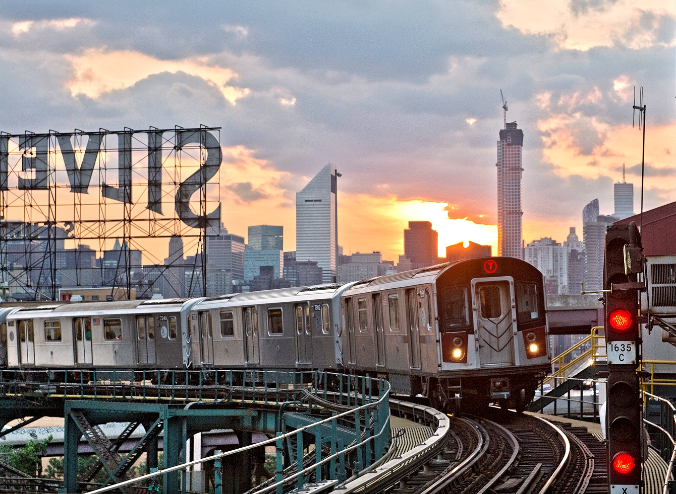
MTA Capital Program 2015-2019
Renew. Enhance. Expand.
Briefing to NY Building Congress
November 13, 2014
Notes:
Good Morning. I am very pleased to be here to present the proposed MTA 2015-2019 Capital Program
Over the past year, we have worked long and hard to carefully craft this program, combining projects that:
Renew the system for safe and reliable service
Enhance and expand the network to create the 21st century system our customers expect and meet the demands of the regional economy.

Slide 2
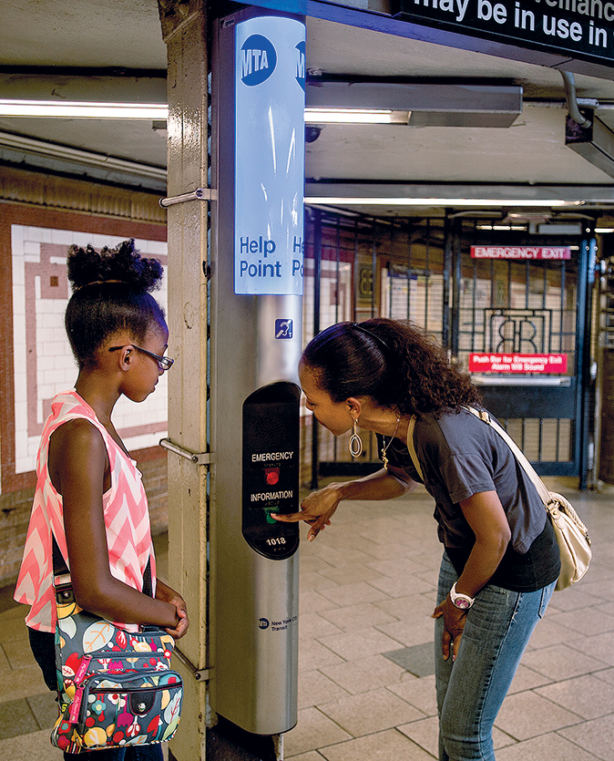
Agenda
Importance of System
Evolution of Investments
Better Capital Program
Program by agency
Funding
Notes:
Photo shows Help Point at Brooklyn Bridge.
Today we will start with an overview that reflects on the importance of the MTA for moving the regional economy
Benefits delivered by the Capital Program, and what we will do to make this new program even better
Evolution of the Capital Program
Things we will do to improve the Capital Program
Program highlights, agency-by-agency
Funding

Slide 3
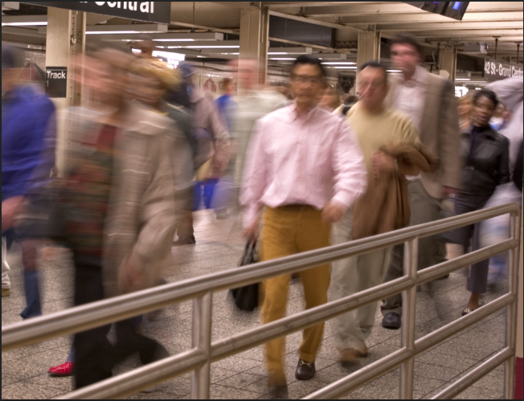
The MTA System: Moving the Regional Economy
Our system is the backbone of an economy representing 11% of national GDP
2
New York is the second largest metro economy in the world
2.62 billion
Total trips we provide to customers each year
$44 billion
Economic impact of 2010-2014 Capital Program throughout the state
24/7
Hours of system operation
Local/Express
Two types of transit service for one flat fare
18,000
Construction jobs for MTA projects in 2012
8.7 million
Average weekday customers
6,465
Subway cars; the largest subway car fleet in the world
713
Subway (468) and commuter rail (245) stations
9
Highway bridges and tunnels
Notes:
Importance of the MTA system to regional economy cannot be overstated.
NY is the second largest metropolitan economy in the world, second only to Tokyo.
Each year, we provide 2.6 billion trips to the 15.1 million people living in the region.
The 2010-2014 Capital Program is estimated to have generated 350,000 jobs across New York, with an overall economic impact of $44 billion throughout the State.
We have more bus riders than any other public agency in North America.
Over 80% of regional commuters ride our system to work.
Our system makes it possible for the regional economy to work, benefitting the entire State.

Slide 4
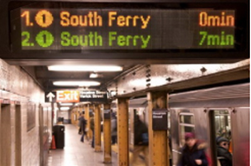
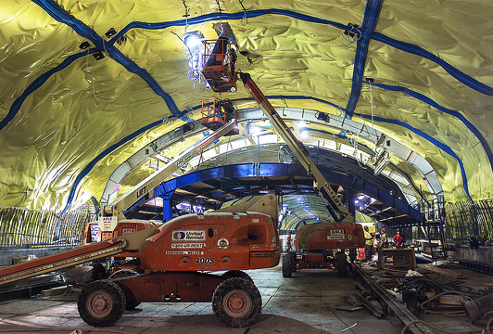
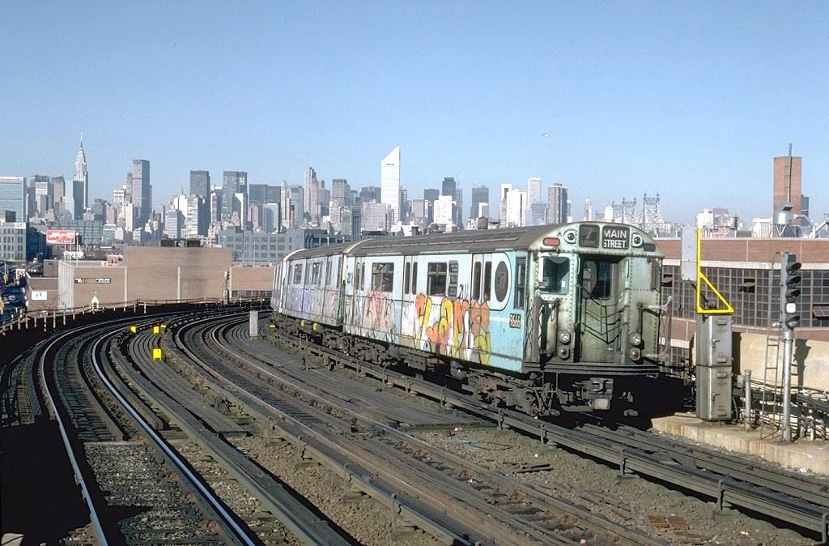
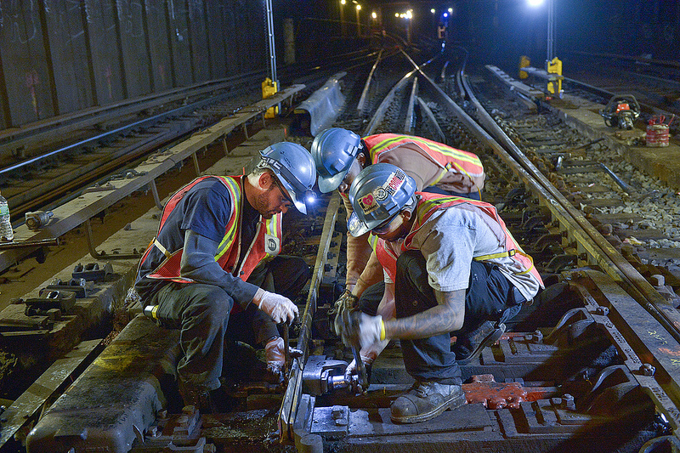
Evolution of MTA Capital Investment
Improve
Expand
Stabilize
Reinvest
Expand
Improve
Investment Split
Stabilize / Reinvest
’82-’91
’92-’99
’00-’04
’05-’09
’10-’14
Notes:
1982 was the start of our first Capital Program
As you know, the MTA network was in poor condition after a long period of underinvestment.
Early capital plans was to stabilize the system and begin to reverse the deterioration through basic investments to restore and bring critical assets to a state of good repair.
This stability allowed the MTA to improve services throughout the network and undertake key expansion work.

Slide 5
Why We Make Capital Investments: Benefits
Service has improved, generating increased ridership
Asset condition
Reliability
82%
MTA-Wide SGR
Increased distance between failures:
  1,250% on the subway
  1,000% on LIRR
  500% on Metro-North
On-time performance
Fewer service delays:
  94% on the subway
  48% on LIRR
  85% on Metro-North
Notes:
Well, what’s changed?
82% of our assets are in SGR / fit for purpose
The reliability of our rail fleets has increased tremendously. For example, the Subway fleet has gone from 11k MDBF to 135k MDBF.
This has transformed on-time performance, with delays falling by 48 to 94%!
As a result, ridership is up 61% since 1992 and continues to grow.

Slide 6
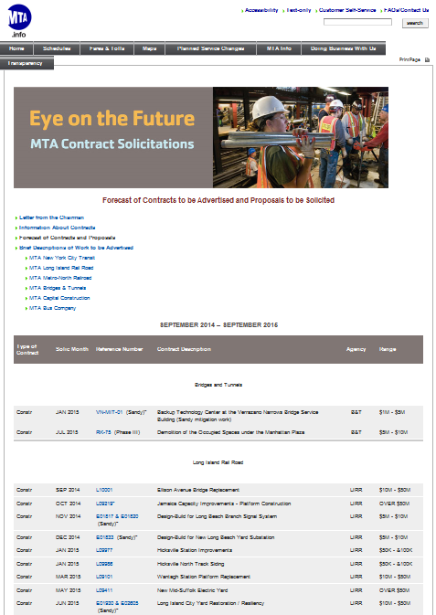
A Better Capital Program
Improving how we do business…
Private Sector Partnership
Increase private-sector partnering, e.g., more design-build contracts
Transparency
Provide consultants, contractors, and the public with easy access to upcoming procurements
Mentoring
Increase the number of vendors qualified to do business with the MTA
Notes:
We are also working to improve how we do business for this 2015-2019 Program:
1) More design-build
2) Improve contract T’s & C’s
These help to place risks with those who can better manage them.
We will advance transparency initiatives to provide the public with detailed information on each 2015-2019 project.
We will expand our industry-leading Small Business Development Program (SBDP,) to grow the pool of vendors qualified to bid on our jobs.

Slide 7
2015-2019 Capital Program Overview
The health and prosperity of our economy depends on a safe, reliable transit system that will continue to grow and adapt along with our region
Our first priority is to protect the safety, reliability and quality of existing MTA service. This means replacing and repairing trains, buses, and subway cars, and maintaining the track, signals, yards, depots, bridges and stations.
Renew
System and service improvements help us to better serve our customers, through initiatives such as station ADA accessibility, next train arrival information, and New Fare Payment technology.
Enhance
Expanding the reach of the MTA network enables us to deliver more extensive and resilient service:
Continue East Side Access
Start Second Avenue Subway Phase 2
Start Penn Access
Expand
Notes:
We built our investments around three main strategic objectives:
Renew
Enhance
Expand
Our first priority is to renew the system, to ensure the safety of our customers and reliability of our service.
Our next priorities are to enhance the system, improving the customer experience through service and system improvements and to expand the reach of the system to support regional economic growth and respond to increasing demand.

Slide 8
2015-2019 Capital Program Budget
NYCT / MTA Bus
$17.6 b
LIRR / MNR
$5.7
PD / Interagency
$0.2
CPRB Core
$23.5
MTACC / Expansion
$5.5
CPRB Total
$29.0
B&T
$3.1
MTA Total
$32.0 b
Notes:
This slide shows a breakout of the proposed $32 billion budget.
55% NYCT, which carries over 80% of our public transit passengers.
20% for the Commuter Railroads
20% is allocated for expansion projects
About 10% to B&T
Taking a more detailed look at the Agency-by-Agency program.

Slide 9
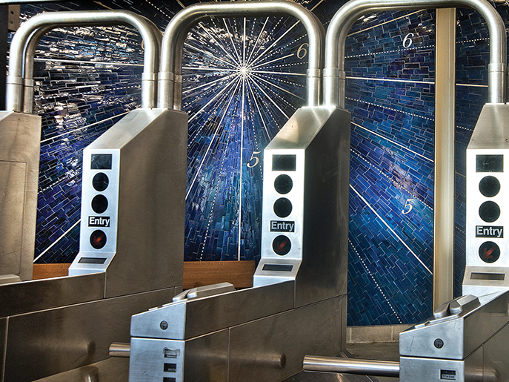
New York City Transit
Smith 9 Sts Station
Notes:
Starting with NYCT, this shows the entry to the recently refurbished Smith 9 Sts station.
In the proposed 2015-2019 Program, these turnstiles you see will be retrofitted to accept new fare media such as cell phones and smart cards as part of the new fare payment system rollout.

Slide 10
New York City Transit: $17.1 billion
Replacement subway fleet (60-foot R211 cars)
Replacement standard, articulated, and express buses
CBTC: 6th Ave Line and Queens Blvd Line + 11 interlockings
B-Division customer information (ISIM-B) + Help Points
Station renewals, components, ADA accessibility
New fare payment system
Grand Central – Lexington and Times Square Shuttle improvements
$3,777 m
SIR replacement fleet + power upgrade
New component repair program
$1,093 m
Cars/
Buses
Signals/
Comms
Stations
Track
Traction
Power
Shops/
Yards/
Depots
Line
Struct.
Line Equip.
Staten Island
Railway
Other
Notes:
The NYC Transit 2015-2019 Plan totals $17.1 billion. The largest area of spending is rolling stock followed by signals, then stations, and track.
Proposed rolling stock purchases for Transit include
the “R-211” fleet which is slated to replace the R-46 fleet in the B-Division and the Staten Island Railway fleet, which are the same vintage.
$1 billion worth of buses including 1,113 standard, 275 articulated buses and 50 express buses
Transit plans to continue with CBTC on the Queens Blvd Line- improving reliability and increasing capacity by 10%- and undertaking CBTC on the 6th Avenue Line in Manhattan and design for CBTC on the 8th Avenue Line.
NYCT’s station renewal and component repair program will make repairs at over 170 stations throughout the system.
Major reconfiguration at the Times Square Shuttle and at Grand Central.
And, the 15-19 Plan will support completion of the rollout of the new fare payment system.
Expanded components to line structures and power: efficiently investments.

Slide 11
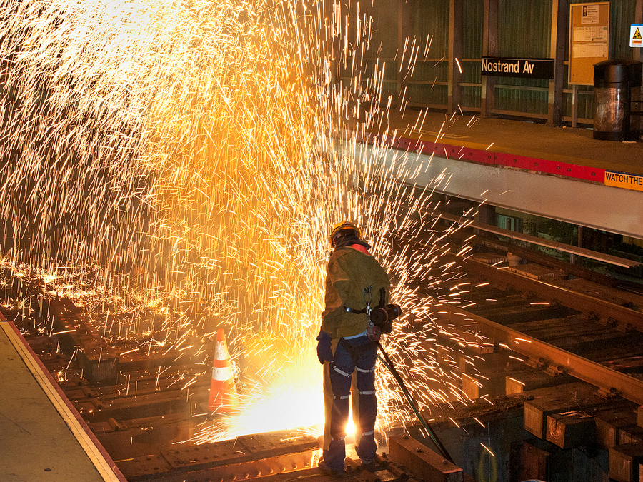
Long Island Rail Road
Atlantic Ave Viaduct
Notes:
LIRR Atlantic Ave viaduct- contractor was Kiewit
Structural rehab, just completed in 2010-2014 program
Design/build
Completed ahead of schedule
On budget

Slide 12
Long Island Rail Road: $3.1 billion
Jamaica Capacity Improvements Phase 2
Main Line Double Track Phase 2
M-9 fleet procurement
Positive Train Control (PTC) + signal component renewals
New Elmhurst station
Station rehabs at Nostrand Av and Hunterspoint Av
Priority station improvements, including Penn Station
$595 m
Begin Huntington/Port Jefferson Yard
Component repairs
$166 m
Track Capacity
Rolling
Stock
Signals/
Comms
Track SGR
Stations/
Parking
Power
Shops/
Yards
Line
Struct.
Other
Notes:
The proposed LIRR 2015-2019 Capital Program totals $3.1 billion. A large share of this will continue the Rolling Stock and Track capacity investments begun in the 2010-14 Program, completing the replacement of the M3 fleet, the Main Line Double Track, and continuing Jamaica Capacity Improvements.
To complement nearly $600m in track capacity improvements, LIRR will invest another $400m to continue to maintain the state of good repair of its existing track assets, bringing the overall track category to $1 billion.
Communications and Signals assets will also see heavy investments:
completion of Positive Train Control
communications network and signal component upgrades
The program also includes considerable work at stations:
Station component work
Renewals are planned for Nostrand Avenue station, Hunterspoint Ave., and Babylon
A new station in Elmhurst and
Design a new station at Republic.

Slide 13
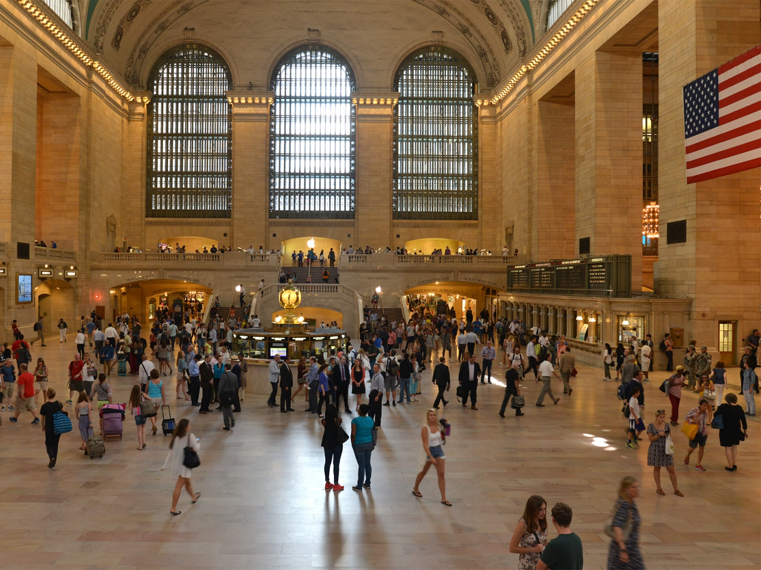
Metro-North Railroad
Grand Central Terminal
Notes:
Moving on to Metro-North Railroad.
This photo shows Grand Central Terminal;
2010-2014 Capital Program included $94 million in investment at Grand Central including a variety of structural and station component work.
Included in the 15-19 program is the replacement of the large train information boards

Slide 14
Metro-North Railroad: $2.6 billion
M-3 fleet replacement
Harmon Shop replacement Phase V
GCT trainshed / tunnel structure rehabilitation
Cyclical investments in rail, track ties, switches, drainage
Renew bridges and viaducts
Positive Train Control (PTC)
Upper Hudson signal improvements
$532 m
Customer communications
Priority station improvements
Renew substations/3rd rail
$170 m
Rolling
Stock
Shops/
Yards
GCT
Track
Line
Struct.
Signals/
Comms
Stations/
Parking
Power
Other
Notes:
Overall, the proposed MNR 2015-2019 Program totals $2.6 billion.
Two key projects represent nearly half of the program:
Replacement of its M3 fleet, which has reached the end of its useful life ($532m) and
Final phase of the Harmon Shop replacement, supporting 80% of the shop operations on the railroad
This proposed plan also includes:
Structural rehabilitation of the GCT train-shed and tunnel structure
SGR investments in track, bridges, and tunnels
Customer Communication system for Grand Central Terminal and outlying stations.
Completion of Positive Train Control system
Signal improvements on the Upper Hudson Line.
Power investments focusing on substations and 3rd rail

Slide 15
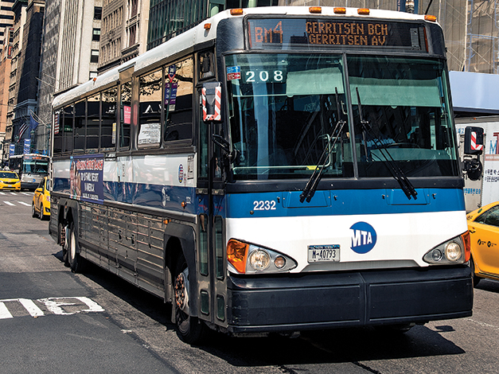
MTA Bus
Express Bus
Notes:
Turning to MTA Bus, which complements NYCT Bus operations within the five boros…
This photo shows one of the express buses purchased in the 2000-2004 Program.
These buses are nearing the end of their useful life and the proposed 2015-2019 MTA Bus Program will replace them.

Slide 16
MTA Bus: $0.4 billion
Replacement express buses
On-board customer information
New bus radio system
Depot component rehabilitations
Introduction of articulated buses
$278 m
$40 m
Express
Buses
Radio/
Systems
Depots
Articulated
Buses
Other
Notes:
The proposed 2015-2019 Capital Program for MTA Bus totals $437 million and mainly focuses on fleet needs.
406 new buses will be purchased, including 378 high capacity express buses and 28 articulated buses
Balance of the program includes customer information systems and component depot repairs, along with a new bus radio system.

Slide 17
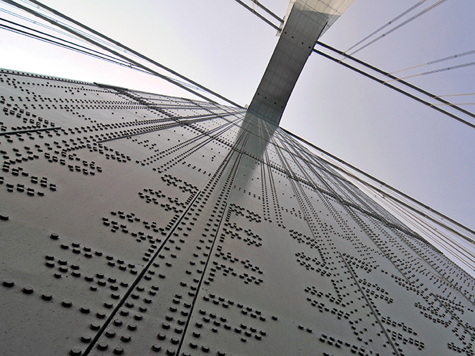
Bridges & Tunnels
Verrazano-Narrows Bridge
Notes:
The last of our operating Agencies is Bridges & Tunnels
This image looks skywards towards one of the massive towers of our Verrazano-Narrows Bridge
Longest suspension bridge in North America (60 feet longer than the Golden Gate Bridge!!)
The 2015-2019 Program will improve traffic flow at the Verrazano Bridge, with a new ramp onto the Gowanus Expressway in Brooklyn.

Slide 18
Bridges & Tunnels: $3.1 billion
Throgs Neck Bridge approach viaduct rehabilitation
Robert F. Kennedy (RFK) Bridge seismic and wind retrofits
Structural rehabilitation at Bronx-Whitestone, RFK, Verrazano-Narrows (VN), Marine Parkway and Henry Hudson Bridges
RFK Bridge Manhattan Toll Plaza structure and approach reconstruction
Throgs Neck Bridge suspended span deck replacement
VN Bridge anchorage decks and Brooklyn approach reconstruction
$1,056 m
Hugh L. Carey Tunnel rehabilitation of ventilation systems
Queens-Midtown Tunnel controls and communication systems rehabilitation
Traveler information systems
Henry Hudson Bridge toll plazas reconstruction
$82 m
Structures
Roadways/
Decks
Utilities
Toll Plazas/
Traffic Management
Structural Painting
Buildings/
Sites
Other
Notes:
Bridges & Tunnels proposes $3.1 billion :
Plan focuses on rehabilitating structures, along with roadways & decks.
Structures category now represents a larger share of the investment portfolio (35%), compared to the prior 2010-2014 Program (19%).
Structures includes a $164 million effort at the Throgs Neck Bridge approaches.
$163 million to retrofit RFK Bridge to better withstand seismic and wind forces.
$333 million to replace suspended span deck at Throgs Neck Bridge
$90 million to rehab Hugh Carey Tunnel ventilation systems.
The program also includes a new ramp linking the RFK Bridge with the northbound Harlem River Drive, in coordination with NYCDOT.

Slide 19
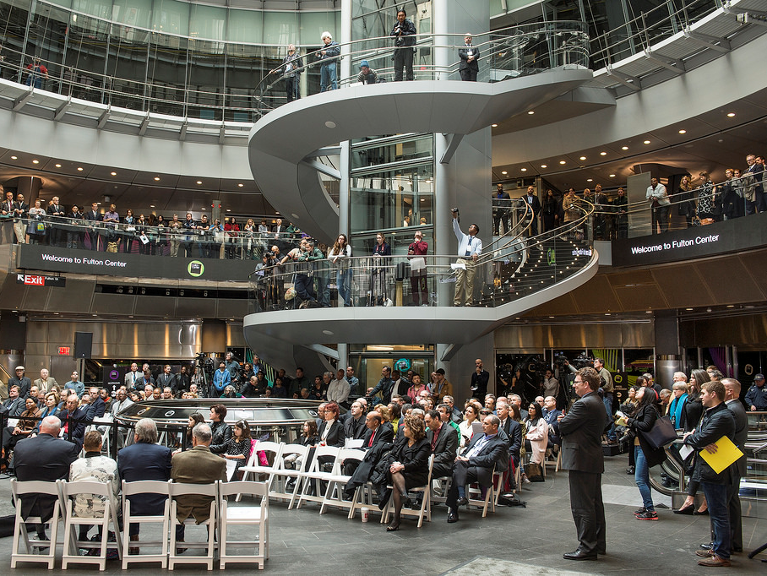
Expansion
Fulton Center
Notes:
Completing the Agency sections with expansion.
This photo shows the grand opening of Fulton Center, which took place this past Sunday.

Slide 20
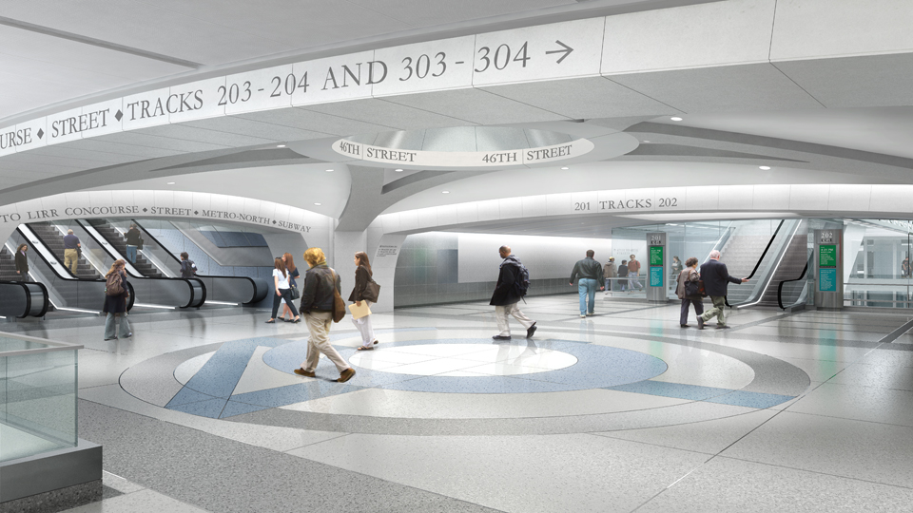
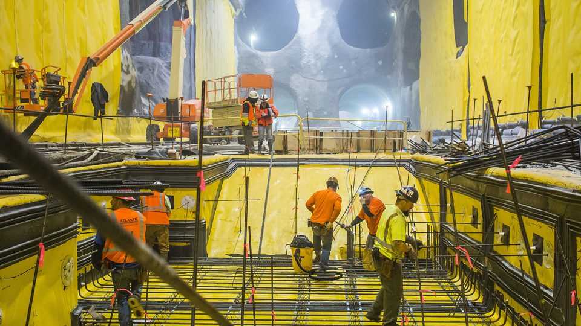
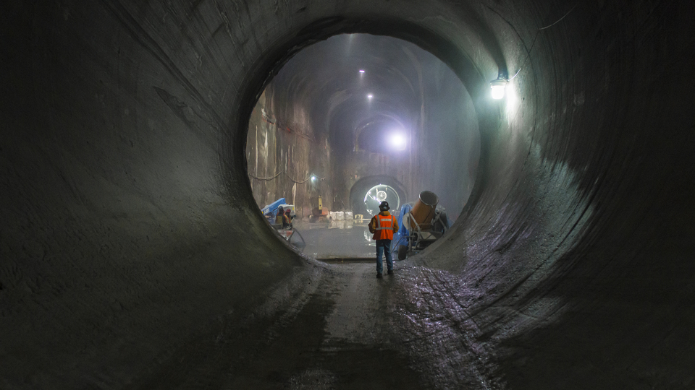
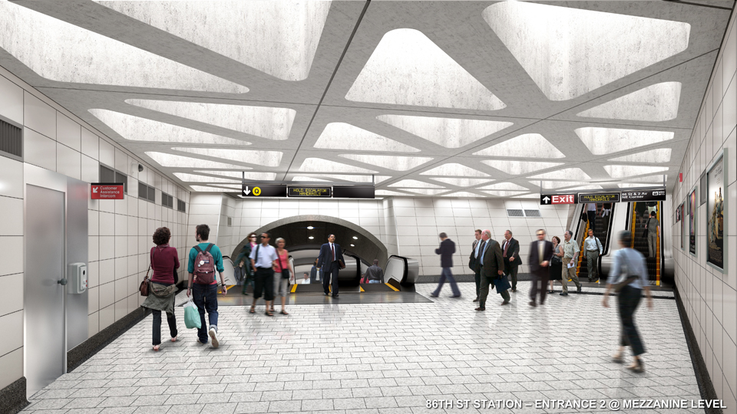
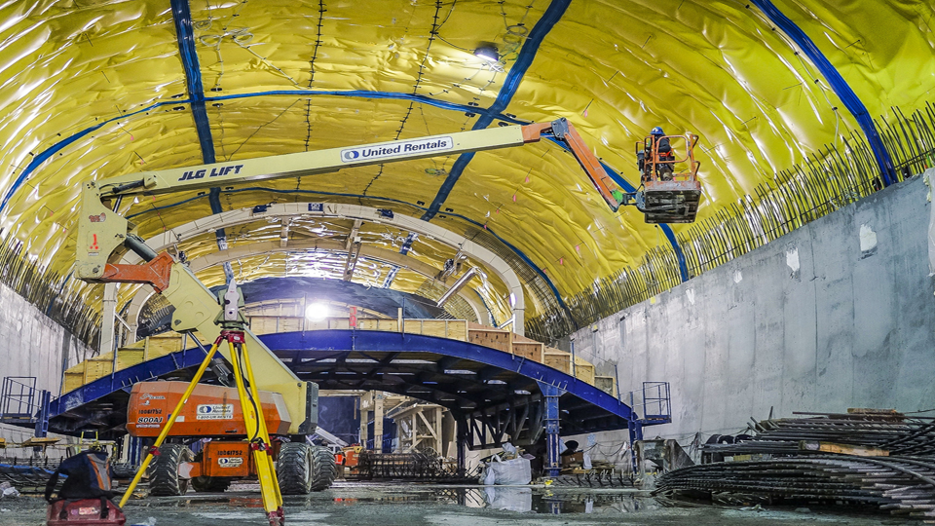
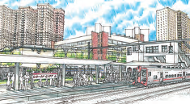
Expansion: $5.5 billion
Complete LIRR
East Side Access to
Grand Central Terminal
Design and early
construction
of next SAS Phase
$2,882 m
Metro-North
connection
to Penn Station
$359 m
ESA/
Regional
Investments
Second Ave Subway Phase 2
Penn Station
Access
Other
Notes:
The program proposes $5.5 billion for expansion.
$2.9 billion is allocated to complete East Side Access.
Phase one of the 2nd Avenue Subway is on schedule to open for service in late 2016.
The 2015-2019 Capital Program allocates $1.5 billion to commence the second phase of the project.
Plan will fund design, utility relocation, and tunneling for Phase 2, which extends from 96th St up to 125th St. Future plans will fund remaining Phase 2 work.
Penn Station Access will bring Metro-North New Haven Line service into Penn Station NY via Amtrak’s Hell Gate Line.
The plan will fund the infrastructure, including four new stations in the Bronx. (Co-op City, Morris Park, Parkchester/Van Nest, and Hunts Point)

Slide 21
2015-2019 Capital Program Funding
Funding Projected
$16.9 b
Gap to Fill
$15.2
Program Costs
$32.0 b
Notes:
The proposed program totals $32 billion.
Funding it relies on a mix of support from federal, city, state, and MTA sources.
So far, we have identified approximately $17 billion in projected funding.
There remains a $15 billion gap that must be filled in order for the MTA to implement our 15-19 program proposal.
To meet this challenge, we will need your support and work with our funding partners to help fill the gap with contributions from the system’s many beneficiaries, including new dedicated revenues, private funds or in-kind contributions, additional appropriations from state, federal, and local governmental funding partners,… or new MTA debt.

Slide 22
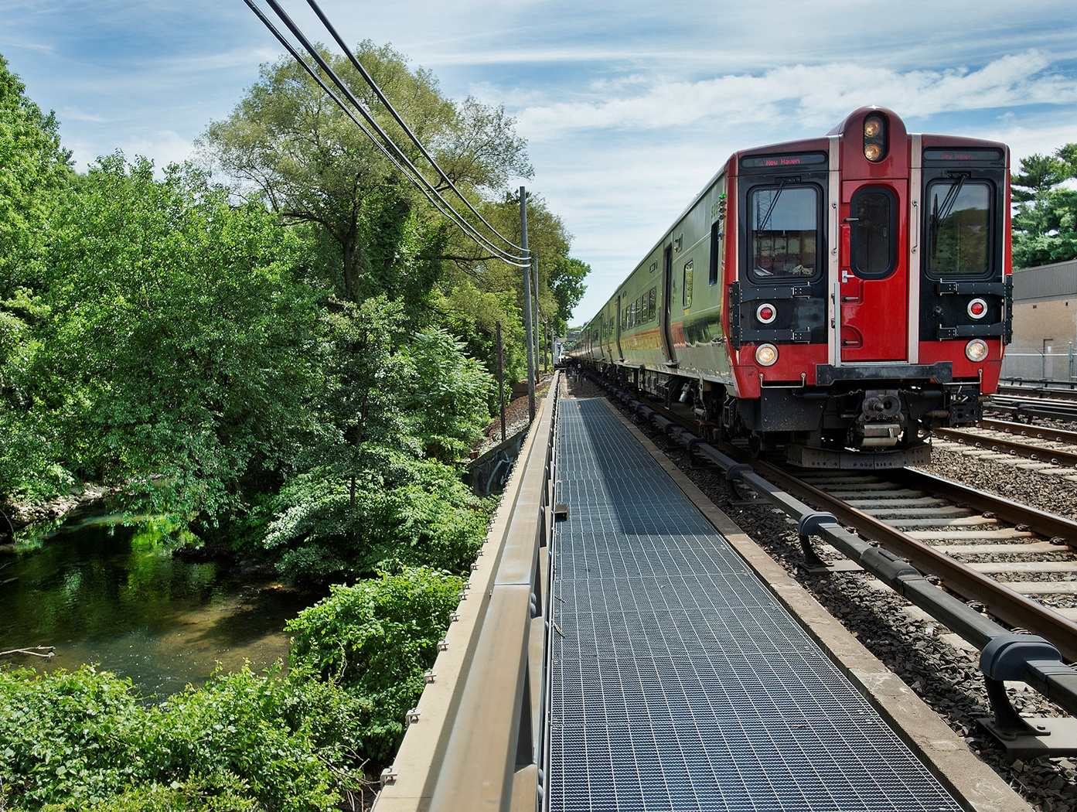
Moving Forward
Program available at: mta.info/capital
Sep 2014
Oct 2014
On-going
Plan approved by MTA Board
Submit plan to CPRB for approval
Dialogue with City, State, and other stake- holders
✓
✓
Notes:
We are looking forward to moving forward with this Program and delivering vital investments that will improve the MTA network.
The full Capital Program book is available for download on our Capital Program web site at: mta.info/capital
The MTA Board approved the Program, but it was then vetoed by the Capital Program Review Board.
We are continuing the dialogue with state, city, and other stakeholders and the program will be resubmitted in the months ahead.
We thank you for your attention and look forward to your support in advancing this Capital Program.

